Slide 1



Placement Statistics AY 2023-24
Presented by
Dr. Priyanka Kokil
Chairperson - Placements

Slide 2
Placement Statistics AY 2023-24
Effective Strength ( Students who applied for less than 5 companies are removed) | No of Offers as on date | Effective Strength | Placement % as on 17th Aug
319 | 217 | 319 | 68
Package AY-2023 Vs AY-2024
Growth Over Last Year | AY 2022-23 | AY 2023-24 (as on date)
Highest package | 32 LPA | 35.39 LPA
Average Annual Package | 10.84 LPA | 12.78 LPA

Slide 3
Department wise Placed & CTC Details - AY 2023-24
Branch wise No of Students placed & CTC details (AY 2023-24) |  |  |  | Package in LPA
Course | Department | Effective Strength | Placed Students | Maximum |  | Average |  | Minimum
B.Tech | CSE | 95 | 68 | 14,00,000 |  | 8,94,523 |  | 3,30,000
 | ECE | 58 | 35 | 29,05,790 |  | 9,48,646 |  | 3,30,000
 | Mechanical | 41 | 30 | 15,21,600 |  | 5,78,571 |  | 3,00,000
 | Smart Manufacturing | 17 | 8 | 7,50,000 |  | 6,75,000 |  | 6,00,000
Dual Degree (B.Tech + M. Tech) | Computer Science and Engineering | 39 | 26 | 35,39,732 |  | 19,19,447 |  | 7,50,000
 | ECE - Communication Systems Design | 12 | 6 | 31,62,000 |  | 19,74,976 |  | 6,00,000
 | ECE- VLSI Design | 15 | 11 | 18,78,480 |  | 17,32,784 |  | 11,50,000
 | Mechanical - Advanced Manufacturing | 12 | 11 | 9,00,000 |  | 7,87,500 |  | 7,50,000
 | Mechanical Engineering - Product Design | 13 | 11 | 12,00,000 |  | 8,26,667 |  | 6,00,000
M. Tech. | CSE- Data Science and AI | 2 | 0
 | ECE - Communication Systems | 4 | 3 | 11,50,000 |  | 11,25,000 |  | 11,00,000
 | Mechanical - Mechanical Systems Design | 1 | 1 | 5,00,110 |  | 5,00,110 |  | 5,00,110
 | Mechanical - Smart Manufacturing | 2 | 0
 | ECE- Microelectronics and VLSI Systems | 8 | 6 | 40 K/month - 1 Yr Internship (PPO awaited)
M.Des | Integrated Product Design | 1 | 1 | 8,00,000 | 8,00,000 |  | 8,00,000
 | Grand Total | 319 | 217
Course | Package in LPA
 | Maximum | Average | Minimum
B.Tech | 29.05 | 9.75 | 3.00
Dual Degree (B.Tech + M. Tech) | 35.39 | 17.36 | 6.00
M. Tech. | 11.50 | 11.25 | 5.00

Slide 4
Highest Package offered Companies - AY 2023-24
Course | Department | Highest Package | Company Name
B.Tech | Computer Science and Engineering | 14,00,000 | Valeo
 | Electronics and Communication Engineering | 29,05,790 | Analog Devices India Pvt. Ltd
 | Mechanical Engineering | 15,21,600 | Tvasta Manufacturing Pvt Ltd
 | Smart Manufacturing | 7,50,000 | PGP Glass Pvt Ltd
Dual Degree (B.Tech + M.Tech) | Computer Science and Engineering | 35,39,732 | Marvell India Pvt Ltd
 | Electronics and Communication Engineering - Communication System Design | 31,62,000 | Analog Devices India Pvt. Ltd
 | Electronics and Communication Engineering - VLSI Design | 18,78,480 | AMD
 | Mechanical Engineering - Advanced Manufacturing | 9,00,000 | Congruent Solutions Pvt Ltd
 | Mechanical Engineering - Product Design | 12,00,000 | Anand Group
M.Tech | Electronics and Communication Engineering - Communication Systems | 11,50,000 | Tata Consultancy Services (TCS)
 | Mechanical Engineering - Mechanical Systems Design | 5,00,110 | Foxconn (Yuzhan Technology)
M. Des | Integrated Product Design | 8,00,000 | Psyxi Devices Pvt Ltd

Slide 5
Company wise Offer Details - AY 2023-24
S.No | Company Name | Positions Offered | S.No | Company Name | Positions Offered
1 | Academor | 29 | 31 | Textron | 2
2 | TCS (NQT) | 19 | 32 | Tiger Analytics | 2
3 | Foxconn | 16 | 33 | Congruent Solutions Pvt Ltd | 2
4 | AMD | 14 | 34 | Neoware | 2
5 | Kynhood Technologies Pvt. Ltd. | 10 | 35 | Microchip | 2
6 | Tata Consultancy Services (TCS) | 9 | 36 | Mahindra & Mahindra | 2
7 | GAVS Technologies Pvt. Ltd. | 9 | 37 | Anand Group | 1
8 | TensorGo | 6 | 38 | BeeHyv Software Solutions Pvt Ltd | 1
9 | Quantrium | 5 | 39 | Brakes India Private Limited | 1
10 | trimble | 5 | 40 | Cambridge Mobile Telematics | 1
11 | Valeo | 5 | 41 | Data Patterns (India) Ltd. | 1
12 | Peninsular Research Operation | 5 | 42 | Greaves Cotton Ltd | 1
13 | Besmak Components Pvt Ltd | 4 | 43 | IdeyaLabs | 1
14 | KLA | 4 | 44 | Kriatec Services Private Limited | 1
15 | Wayspire Ed-Tech Private Limited | 4 | 45 | Larsen & Toubro Limited | 1
16 | Apex Semiconductors | 4 | 46 | MathWorks India Pvt Ltd | 1
17 | Analog Devices India Pvt. Ltd | 3 | 47 | Mu Sigma | 1
18 | Tvasta Manufacturing Pvt Ltd | 3 | 48 | Pi Square Technologies India (PSTI) | 1
19 | Checktronix India Pvt Ltd. | 3 | 49 | SVP LASER TECHNOLOGY Pvt. Ltd. | 1
20 | Marvell India Pvt Ltd | 3 | 50 | TuTr Hyperloop Pvt. Ltd | 1
21 | NeoMotion | 3 | 51 | Varroc | 1
22 | Agneyas Labs | 3 | 52 | IISc Periwinkle Labs | 1
23 | Tejas Networks | 2 | 53 | GE Digital | 1
24 | Aqfer India Private Limited | 2 | 54 | Renault Nissan | 1
25 | Kshoonya Inc | 2 | 55 | Saint Gobain | 1
26 | MAQ Software | 2 | 56 | Binocs Labs Pvt Ltd | 1
27 | MBIT Wireless | 2 | 57 | Psyxi Devices Pvt Ltd | 1
28 | MulticoreWare | 2 | 58 | Capgemini | 1
29 | PGP Glass Pvt Ltd | 2 | 59 | BEML | 1
30 | SUJA - SHOEI ICOE (MadeIT) | 2 | Grand Total |  | 217

Slide 6
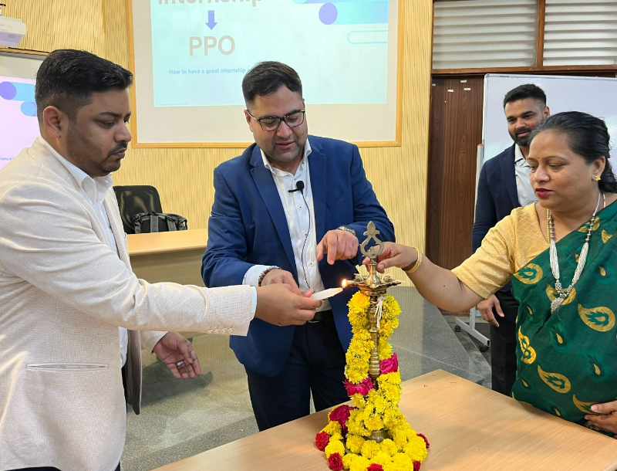
Training Sessions Conducted - AY 2023-24
A 3-day Intensive Training Program Kaaryashaala by Learning from Ant from 29th to 31st March 2024
Sessions Covered
Resume Building
Journey from SIP (Summer Internship) to
PPO (Pre-Placement opportunity)
Effective Communication Skills
Future Opportunities and Challenges
The Discipline of Building Character
Mock Group Discussions
These activities help our students’ feel confident and
ensures their preparedness for the 2025 Placements
therein their Employability chances are improved.
Kaaryashaala (learning from Ant) - Inaugural Session

Slide 7
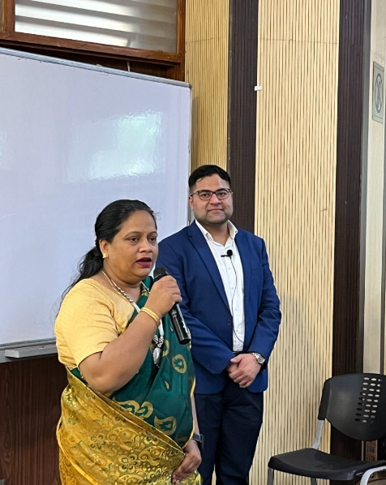
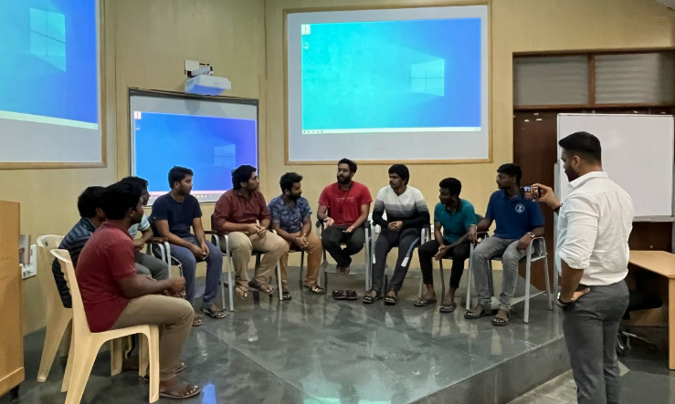
Training Sessions Conducted - AY 2023-24

Slide 8
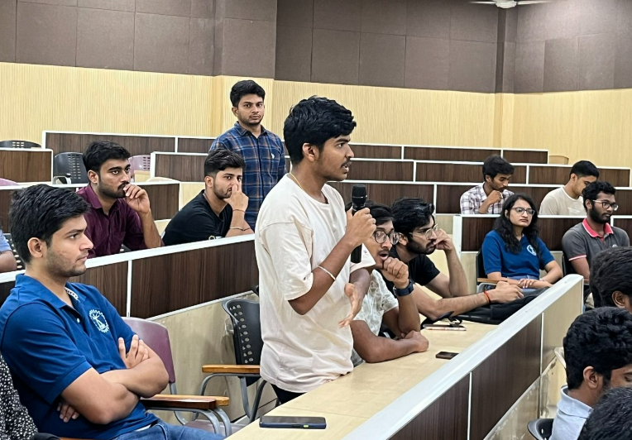
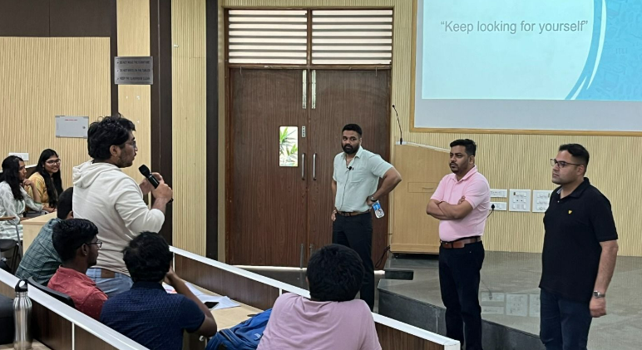
Training Sessions Conducted - AY 2023-24
Kaaryashaala -This workshop is not just focused on making students ready for the Internship and Placement process but on how to seek clarity, confidence, and self-awareness. We are sure that this workshop will provide the answer to three vital questions Why, What and How which in the long run will do the smooth transition of being a professional to a brand.

Slide 9
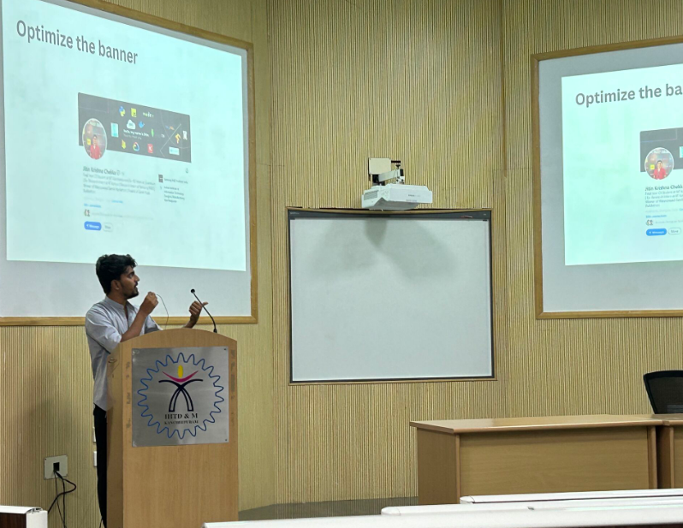
Linked In Session - AY 2023-24
A Session on The Art of Contacting Recruiters through Linked In was conducted on 20th march by our
Placement Coordinator Jashwanth Peddisetty
This activity helps our students to tap the
available Off Campus Opportunities.
Learning Outcomes
Profile Optimization
Outreach Strategies
Relationship Building
Job Search
Mastery in Networking

Slide 10
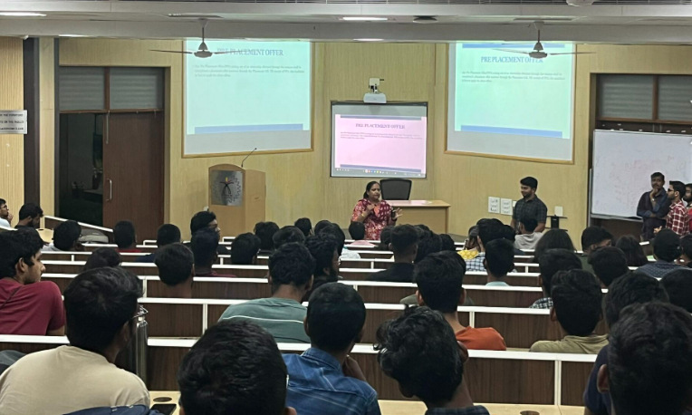
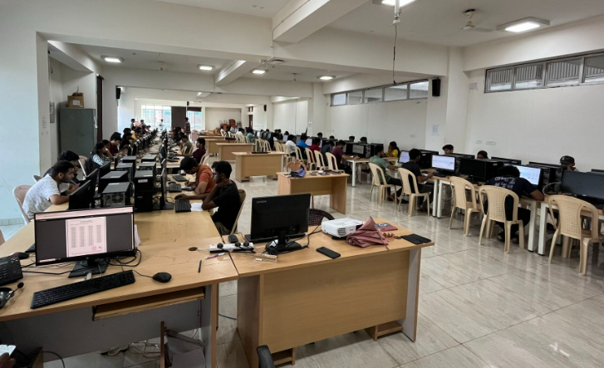
In-House Aptitude Training & Test Sessions
First Step is always the Hardest
To ensure Hassle Free first step, Our Placement Cell conducted Aptitude Training and Weekly Test sessions from 19th Feb to 29th Feb 2024.
Weekly Tests were conducted based on the Topics covered for the entire week during the Training Period. This activity ensures our students to be in touch with the Quant area which ensures them in clearing the first round during the recruitment process.

Slide 11
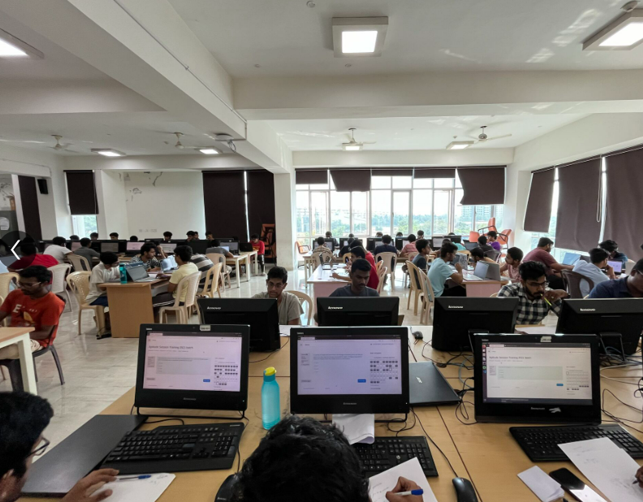
PET (Placement Eligibility Test)
Students have to clear at least 1 PET to sit for the Internship and Placement Opportunities.
PET Questions are based on their curriculum and Basic GATE questions.
This activity ensures the students are trained and ready to face the Recruitment Drive.

Slide 12


Slide 13
Thank You
We wish you All the Best for your New Journey!!

